Slide 1
Economic Inequality in the United States

Slide 2
What do you know about the 1950s?
Income distribution in the 1950s
Current Wealth Distribution

Slide 3
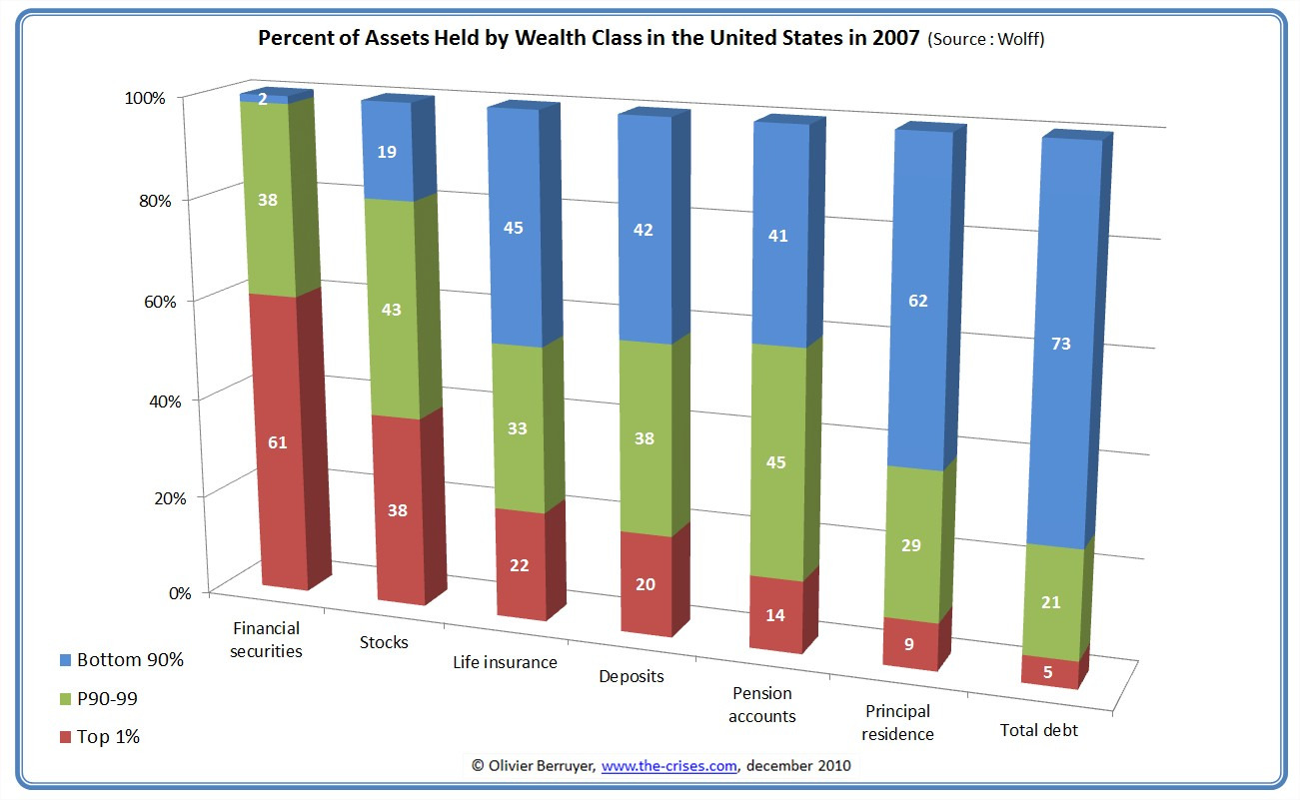

Slide 4
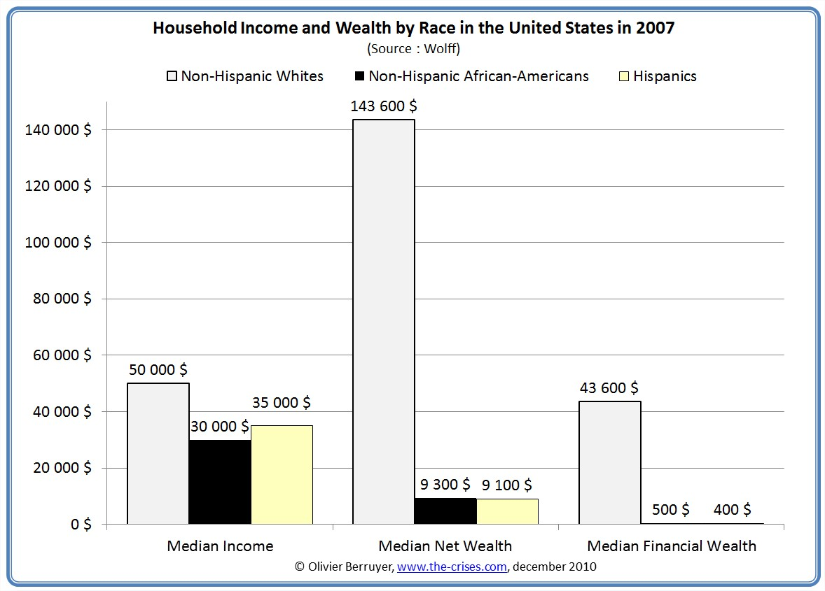

Slide 6
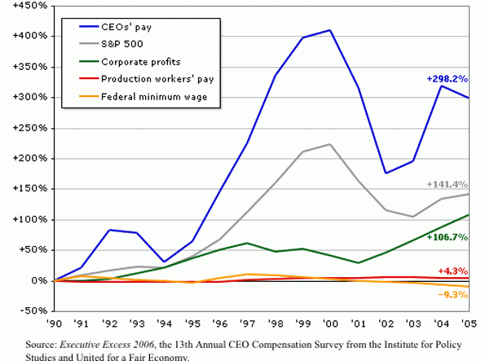

Slide 7
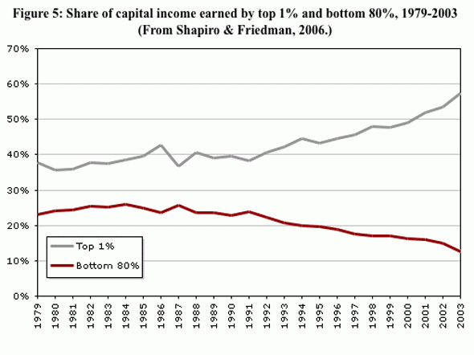

Slide 8
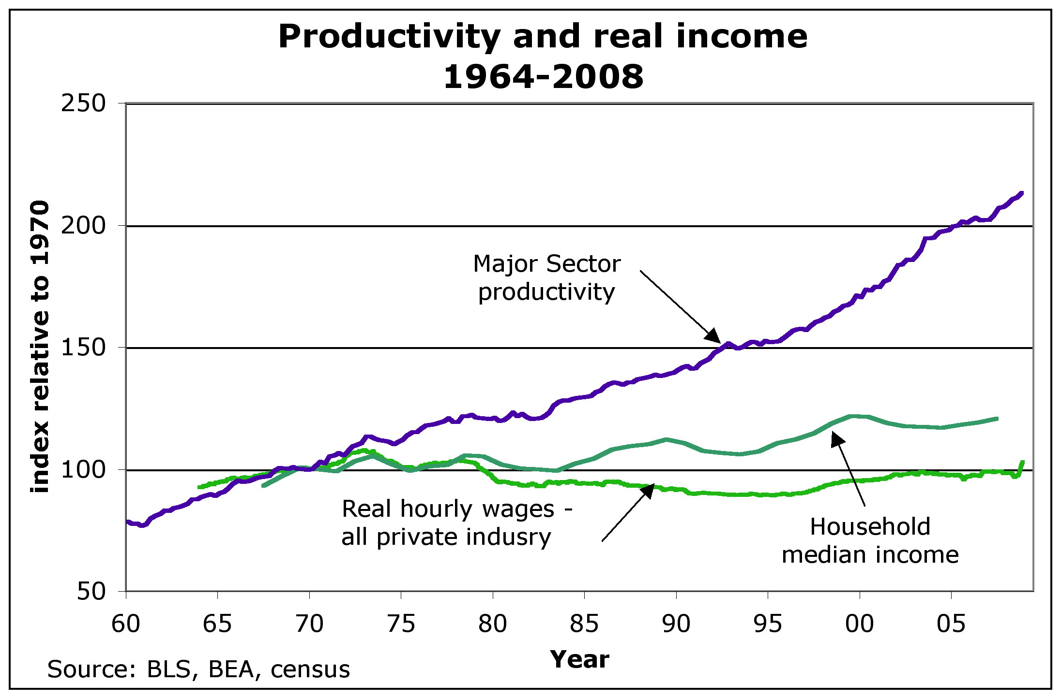

Slide 9
• lower life expectancy
• higher infant mortality
• more homicides
• more anxiety
• more mental illness
• more drug and alcohol addiction
• more obesity
• higher rates of imprisonment
• less social mobility
• more teen pregnancies
• more high-school dropouts
• poorer school performance
• more school-age bullying

