Slide 1
Role of Government?
#1: Should the Government put a special tax on fast foods that they consider to be unhealthy?
Why or why not?
Manager or referee?

Slide 2
#2: Should the government pass laws that ban smoking in public places? Why or why not?
Manager or referee?

Slide 3
#3: Should the government provide unemployment insurance when someone loses a job? Why or why not?
Manager or referee?

Slide 4
#4: Should the government bailout a company that is facing bankruptcy? Why or why not?
Manager or referee?

Slide 5
#5: Should the government provide monetary assistance for food or housing to those facing economic hardships?
Manager or referee?

Slide 6
#6: Should the government pass minimum wage laws that provide low income workers with a higher standard of living? Why or why not?
Manager or referee?

Slide 7
THE DUEL

Slide 8
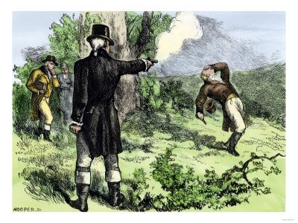
Aaron Burr v. Alexander Hamilton

Slide 9
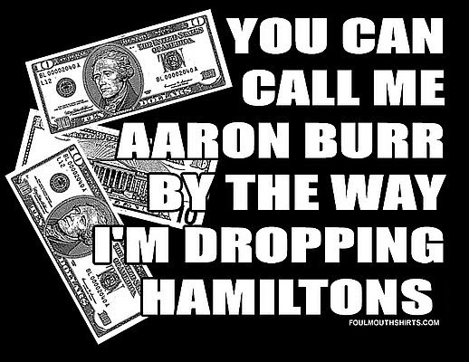
Outcome:
Burr – politically ruined
Hamilton – dead

Slide 10
Hamilton and the Bank of the United States
Stabilize and improve credit
Financial clarity
Both factors allowing the US to grow economically.

Slide 11
History of the Bank
Opposed by Southern agriculturalists as centralized power. (Eventually supported with promise to move the capital to the Potomac)
Hailed by Northern merchants and bankers to help the economy.
“Bank Bill” approved by Washington and bank was chartered for 20 years.

Slide 12
Original US Bank Building. Philadelphia, PA.

Slide 13
History of US banking
First Bank of the United States:
1791-1811
Second Bank of the United States:
1816-1836
“Free banking.” State chartered banks, no
legislative approval needed.
1837-1913

Slide 14
Currency
What is currency?

Slide 15
Super Happy Banking Fun Time
If 50 Sparty Cash = 215 Meijer dollars and
215 Meijer dollars = 94 Kroger dinars and
94 Kroger dinars = 600 Visa points and
600 Visa points = 8 percent tuition waiver and
8 percent tuition waiver = 76942 etokens and
76942 etokens = 564 Amazon points and
564 Amazon points = 4 Detmers dollars what do you get for 64 Aponte Leks?

Slide 16
A Pain in the Burr

Slide 17
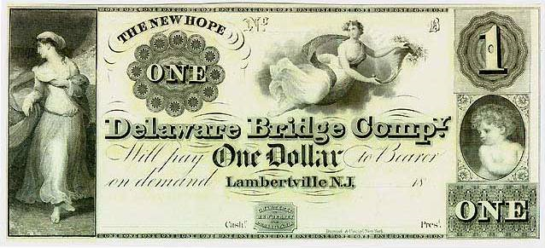
There were over 30,000 different currencies circulating during the free or wildcat banking period.
Most banks averaged only 5 years of service.

Slide 18
National Banks 1863-1913
System of national banks
Created a national uniform currency
Problems:
Bank Runs, seasonal liquidity (when?) , panics, recalling loans

Slide 19
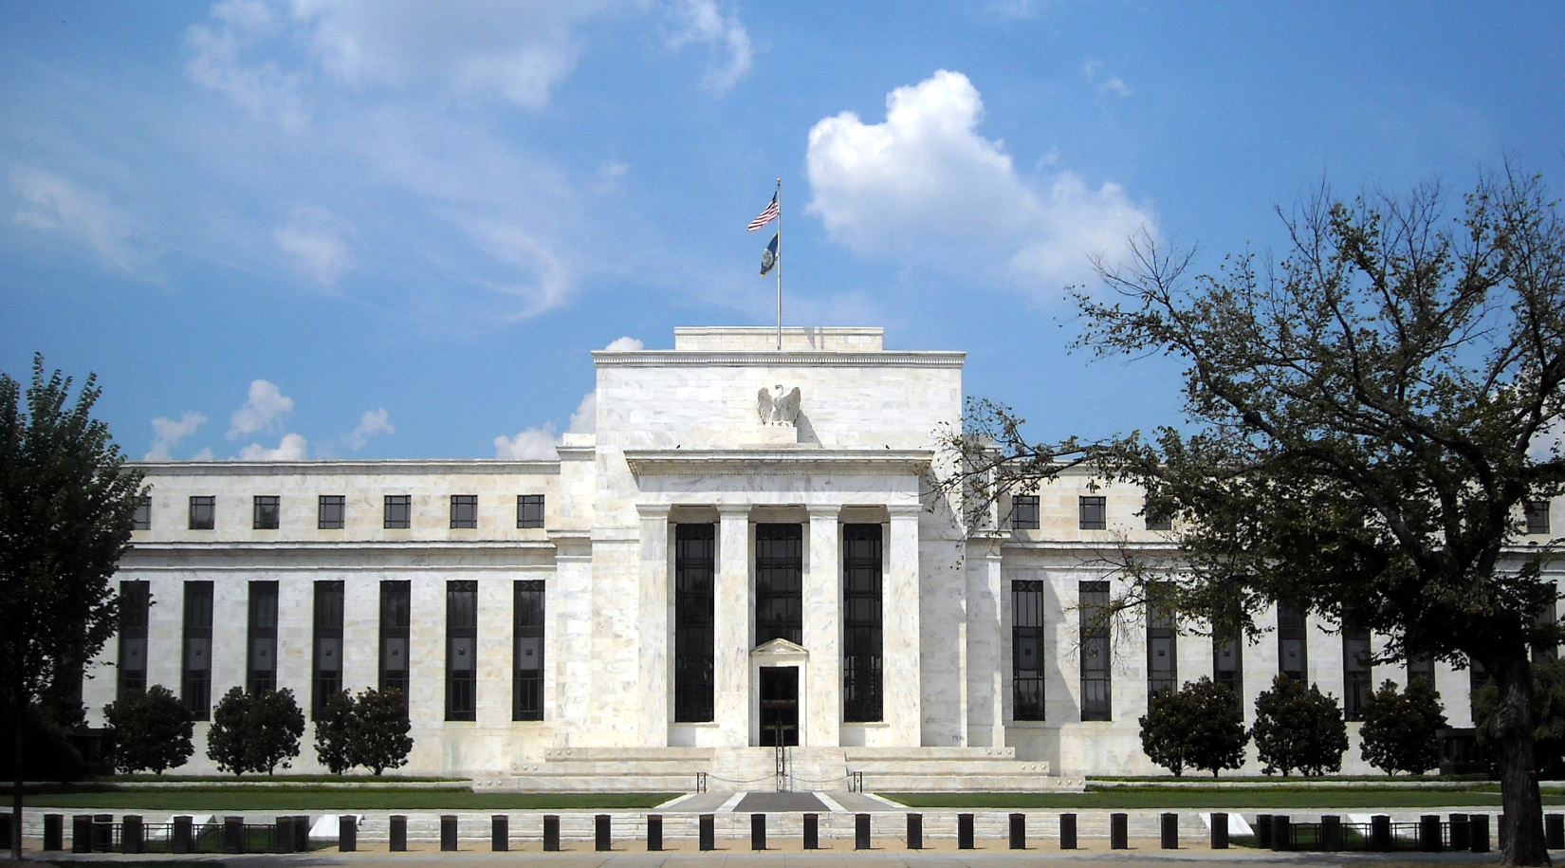
Solution:
The Federal Reserve System

Slide 20
Federal Reserve System:
Maintain a system to make sure banks had money, preventing runs and failures.
Smooth “boom and bust” economic cycles
Prevent Inflation
Prevent Recession

Slide 21
2 Groups:
Board of Governors – manages nation’s money and sets policy
Regional Reserve Banks (12) – carries out policy, oversees other banks and represents private sector (the banks’ banks)

Slide 22
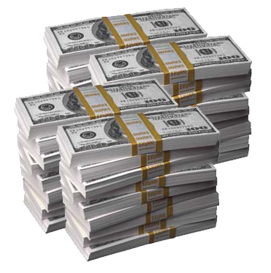
Keep the economy (hopefully) hummin’
Maintain stable prices
Ensure maximum employment
Ensure maximum
production output

Slide 23
12 Regional Districts

Slide 24
In your exit journals:
1. Where is the Regional Reserve Bank for Detroit?
2. Why don’t regional borders match state borders? (brainstorm at least 2 ideas)
3. Which state is furthest from its Reserve Bank?
4. What do you think could happen in the future to change the regional borders?

